Slide 1
Accident Prevention System
IT402 Soft Computing End-Semester Evaluation
Presented by
Sanket (201IT154)
Shaulendra Kumar (201IT159)
Mayur Jinde (201IT135)
Under the guidance of
Nagamma Patil
Assistant Professor
Department of Information Technology
Department of Information Technology
National Institute of Technology Karnataka, Surathkal-575025

Slide 2
CONTENTS
Introduction
Literature Survey
Proposed Methodology
Result Analysis
Conclusion
References

Slide 3
Introduction
The modern world's rapid pace and increased vehicle accidents necessitate innovative solutions to save lives. With approximately 1.35 million annual road accident fatalities globally, there's a critical need for immediate medical response. This project aims to address this by developing an Accident Alert System, leveraging web application technology. By automatically notifying hospitals, ambulances, and family members in real-time, it aims to significantly reduce fatalities caused by delayed medical assistance.
By harnessing the power of web applications and cloud-based communication, this innovative solution holds the promise of saving countless lives by ensuring timely and effective medical responses to road accidents. This outlines the methodology, algorithms, experimental setup, and results of the system, highlighting its potential to mitigate the devastating consequences of road accidents.

Slide 4
Literature Survey
Paper Name | Outcome | Limitation
A Drowsiness Detection System Using Facial Expressions and Head Pose Tracking | The system can effectively detect drowsy drivers based on blinking patterns, yawning, and head pose. | The system requires a good quality camera to track facial features accurately.
Real-time eye blink detection using general cameras: A facial landmarks approach | The proposed algorithm is effective in detecting eye blinks using the Eye Aspect Ratio (EAR) to measure eye openness. | The study was conducted on a small dataset and may not generalize to all populations.
A Driver Drowsiness Detection System Using Infrared Camera | Detects driver drowsiness by monitoring eye closure | Requires good quality camera for accurate eye tracking and may not be suitable for all lighting conditions

Slide 5
Proposed Methodology
Face Detection using Camera:
Activate the camera system within the vehicle dashboard.
Utilize computer vision algorithms to detect the driver's face in real-time.
Calculate Eye Aspect Ratio (EAR) and Mouth Aspect Ratio (MAR):
Employ facial landmark detection techniques to locate key features such as eyes and mouth.
Compute the Eye Aspect Ratio (EAR) and Mouth Aspect Ratio (MAR) using the detected landmarks.
EAR is calculated as the ratio of the distance between vertical eye landmarks to the distance between horizontal eye landmarks.
MAR is calculated as the ratio of the distance between mouth landmarks to the width of the mouth.

Slide 6
Define Thresholds for EAR and MAR:
Set predefined thresholds for EAR and MAR values based on empirical observations and research findings.
Threshold values determine the acceptable range of eye and mouth movements indicative of driver drowsiness or distraction.
Alert Generation:
Compare the calculated EAR and MAR ratios with the predefined thresholds.
If the EAR or MAR values exceed the thresholds, trigger an alert indicating potential driver drowsiness or distraction.
Generate an alarm or visual warning within the vehicle to alert the driver and prompt immediate corrective action.

Slide 7
Continuous Monitoring and Feedback:
Implement a continuous monitoring system to periodically recalculate EAR and MAR ratios.
Provide real-time feedback to the driver regarding their attentiveness level.
Ensure seamless integration with the vehicle's onboard systems for consistent and reliable operation.
Testing and Validation:
Conduct extensive testing under various driving conditions and scenarios to evaluate the system's performance.
Validate the accuracy and effectiveness of the alert generation mechanism through controlled experiments and real-world simulations.
Refine the algorithm parameters and thresholds based on testing feedback to optimize system performance.

Slide 8
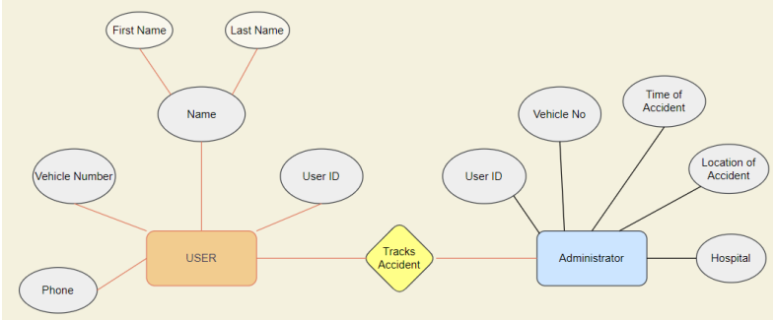
Implementation

Slide 9

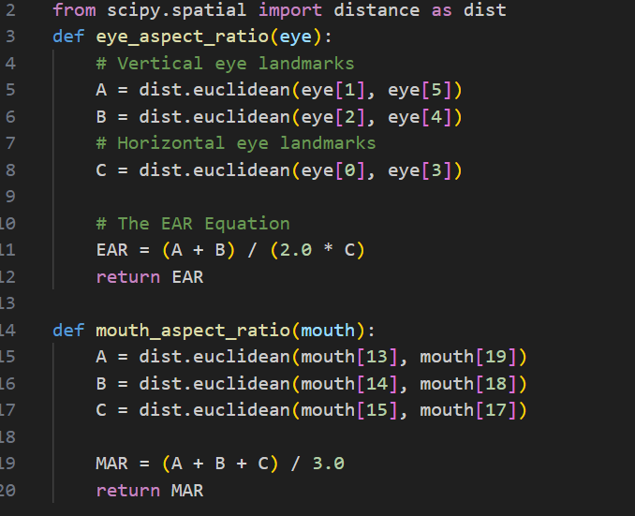

Slide 10
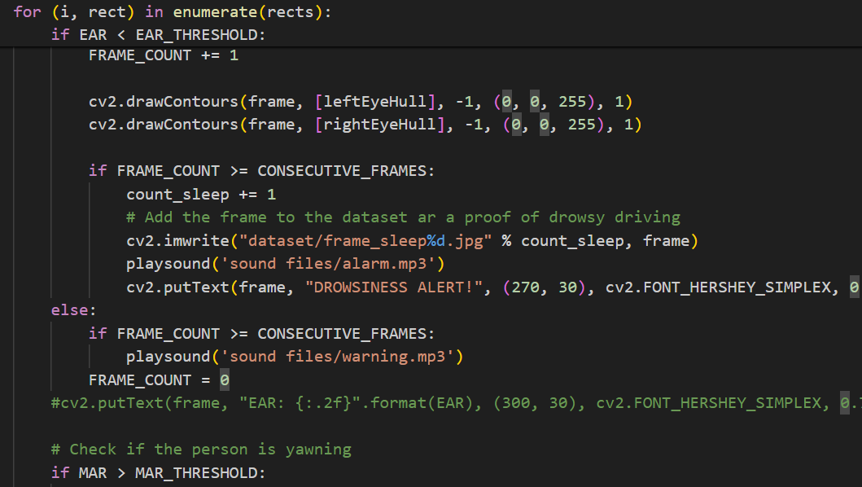

Slide 11
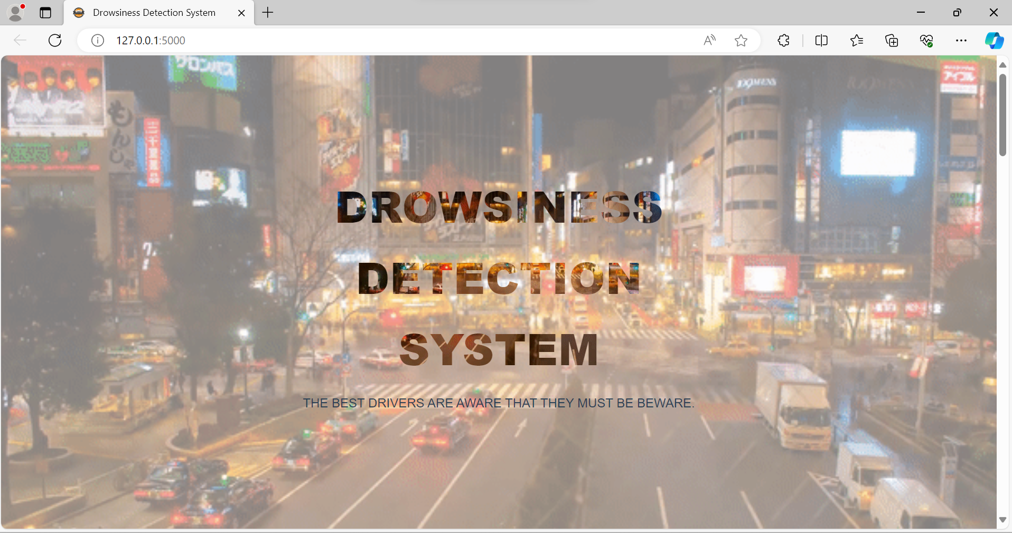
Result Analysis

Slide 12
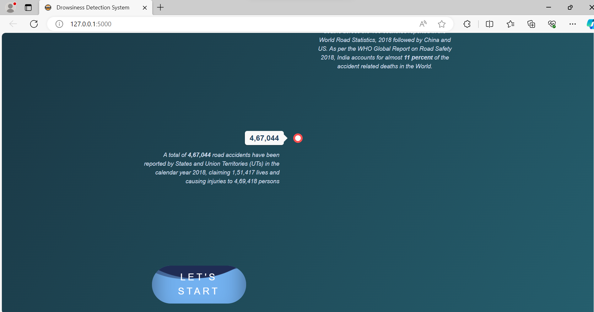
Result Analysis

Slide 13
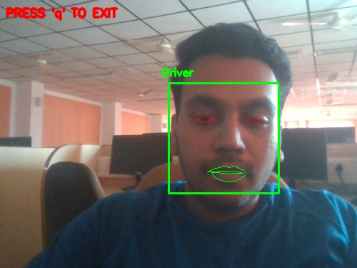
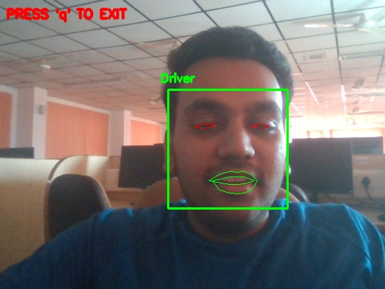
Result Analysis

Slide 14
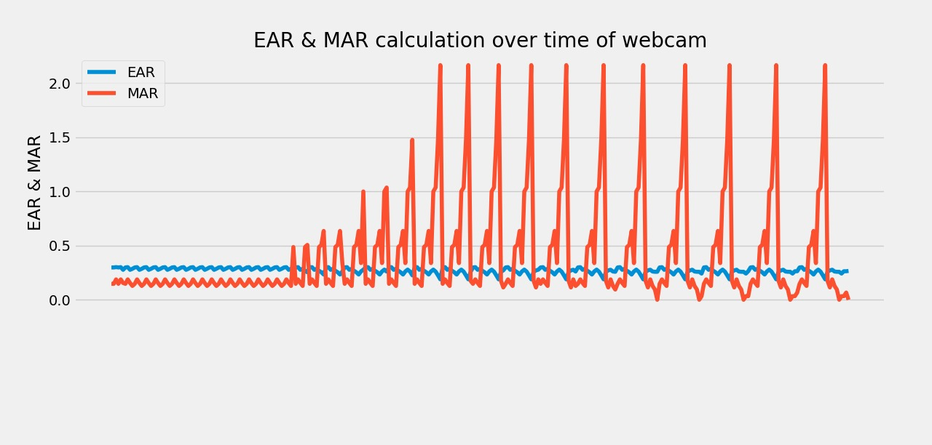
Result Analysis

Slide 15
Result Analysis
Drowsiness detection is a safety technology that can prevent accidents that are caused by drivers who fell asleep while driving. This project is based to provide an effective means to prevent accidents that will detect that a person’s eyes are closed for a few seconds.
This system will alert the driver when drowsiness is detected. OpenCV has been used for gathering the images from the webcam and fed into a Deep Learning model which will classify whether person’s eyes are closed, whether he is feeling sleepy or fatigue which might lead to an accident

Slide 16
Novelty: Improving Alert System
1. Data Preprocessing
Essential step to ensure the model's effectiveness:
Image resizing: Standardizing image dimensions for consistency.
Normalization: Scaling pixel values to a common range (e.g., 0 to 1).
Data augmentation: Introducing variations in the dataset to improve model generalization.

Slide 17
Novelty: Improving Alert System
2. Model Selection: ResNet
ResNet (Residual Neural Network) chosen for its prowess in image classification tasks.
Renowned for its ability to capture complex patterns and features in images.
Residual connections mitigate the vanishing gradient problem, enabling effective training of deep networks.

Slide 18
Novelty: Improving Alert System
3. Training Process
Training the ResNet model on the preprocessed dataset:
Divide the dataset into training, validation, and testing sets.
Feed the images into the ResNet model, extracting features through convolutional layers.
Fine-tune the model's parameters using backpropagation and gradient descent optimization.
Monitor training progress using validation metrics and adjust model architecture or hyperparameters as needed.

Slide 19
Novelty: Improving Alert System
4. Evaluation and Validation
Assessing model performance:
Quantitative evaluation: Calculate metrics such as accuracy, precision, recall, and F1-score on the test dataset.
Qualitative evaluation: Visual inspection of model predictions on sample images to validate effectiveness.
Iterative refinement: Analyze results to identify areas for improvement and fine-tune the model accordingly.

Slide 20
Conclusion
Drowsiness detection is a safety technology that can prevent accidents that are caused by drivers who fell asleep while driving. This project is based to provide an effective means to prevent accidents that will detect that a person’s eyes are closed for a few seconds.
This system will alert the driver when drowsiness is detected. OpenCV has been used for gathering the images from the webcam and fed into a Deep Learning model which will classify whether person’s eyes are closed, whether he is feeling sleepy or fatigue which might lead to an accident

Slide 21
Reference
[1]Facial landmarks with dlib, OpenCV and Python:
https://www.pyimagesearch.com/2017/04/03/facial-landmarks-dlib-opencv-python/
[2]Eye blink detection with OpenCV, Python, and dlib: https://www.pyimagesearch.com/2017/04/24/eye-blink-detection-opencv-python-dlib/
[3]Drowsiness Detection with OpenCV: https://www.pyimagesearch.com/2017/05/08/drowsiness-detection-opencv/
[4]Real-Time Eye Blink Detection using Facial Landmarks:
http://vision.fe.uni-lj.si/cvww2016/proceedings/papers/05.pdf

Slide 22
Thank You

